Slide 1

gross-o-meter
TDI capstone project
Alex An

Slide 2

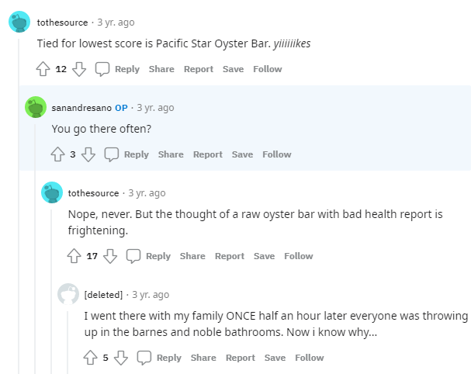
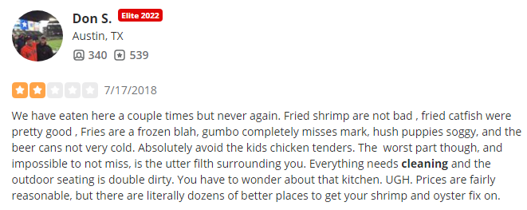
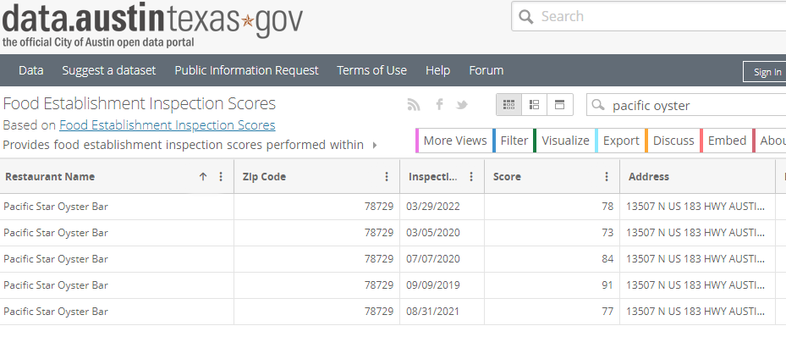
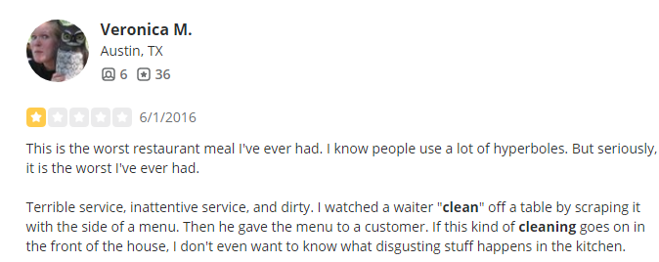

A case study in Austin TX
!!!

Slide 3
The problem
I like going to restaurants, but I don’t like finding out that they’re dingy and dirty when I get there!
Yelp reviews are a great place to figure this out, but the information is buried in the text!
The project
Predict restaurant cleanliness from analysis of review text.
The data
Yelp academic dataset
Scraping Yelp pages
Austin, TX restaurant inspections

Slide 4
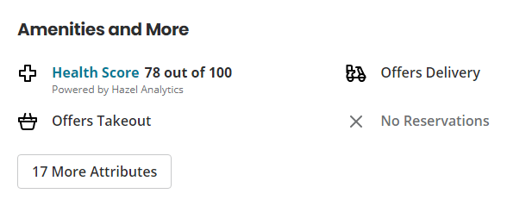
A case study in Austin TX
!!!

Slide 5
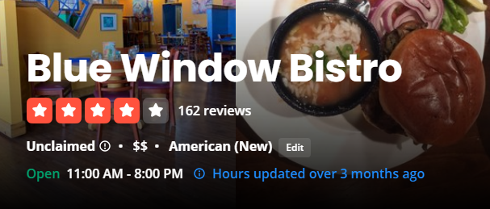
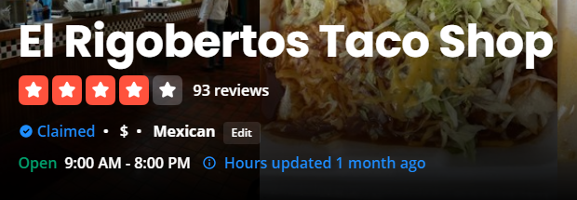
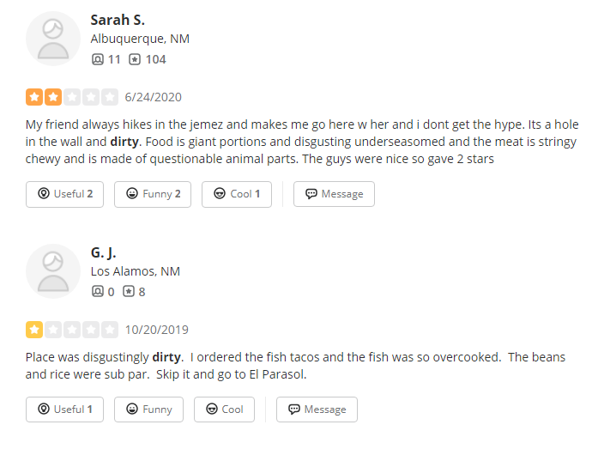
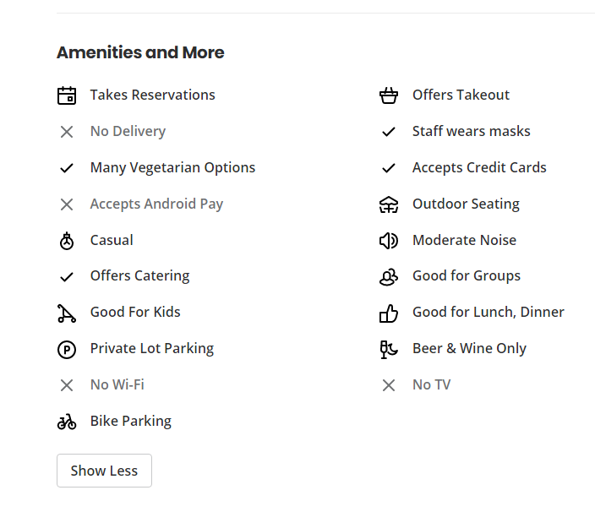
What about other places?
Los Alamos, NM: no scores!
this place was pretty gross…

Slide 6

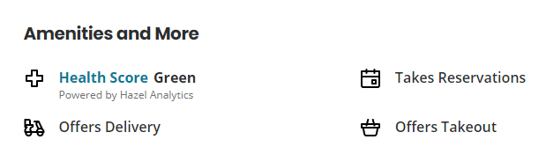
What about other places?
Urbana, IL: what is “green”?

Slide 8
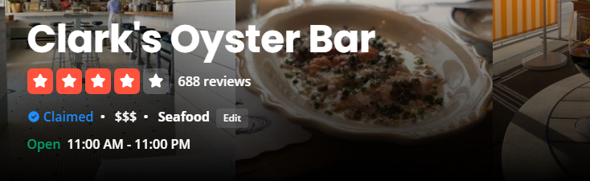
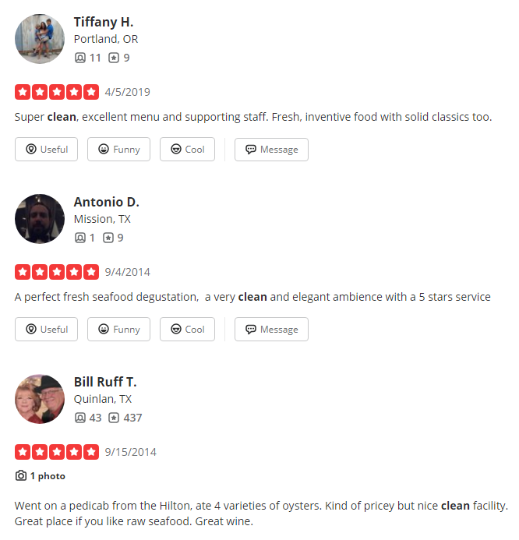

Another Austin oyster bar

Slide 9
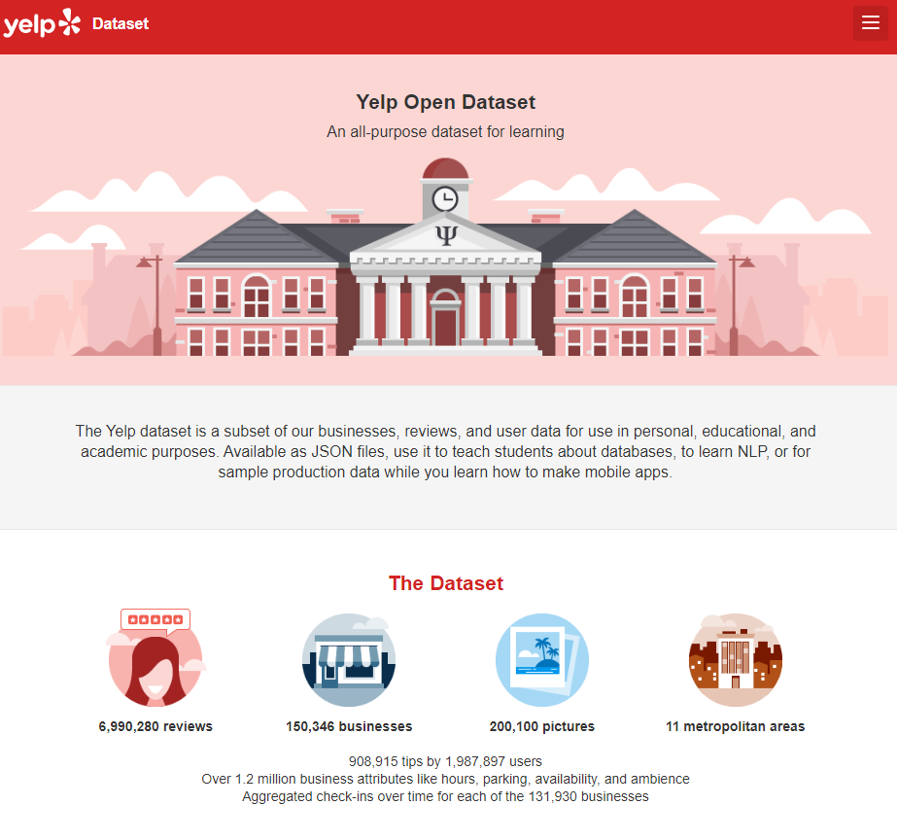
The data….

